Slide 1


Hydropower Social, environmental & economical concerns
Caroline Sundin
csundi@kth.se
Introductory lecture – Energy commodities and technologies
This work by OpTIMUS.community is licensed under the Creative Commons Attribution 4.0 International License. To view a copy of this license, visit http://creativecommons.org/licenses/by/4.0/.

Slide 2
Reference Energy System

Slide 3
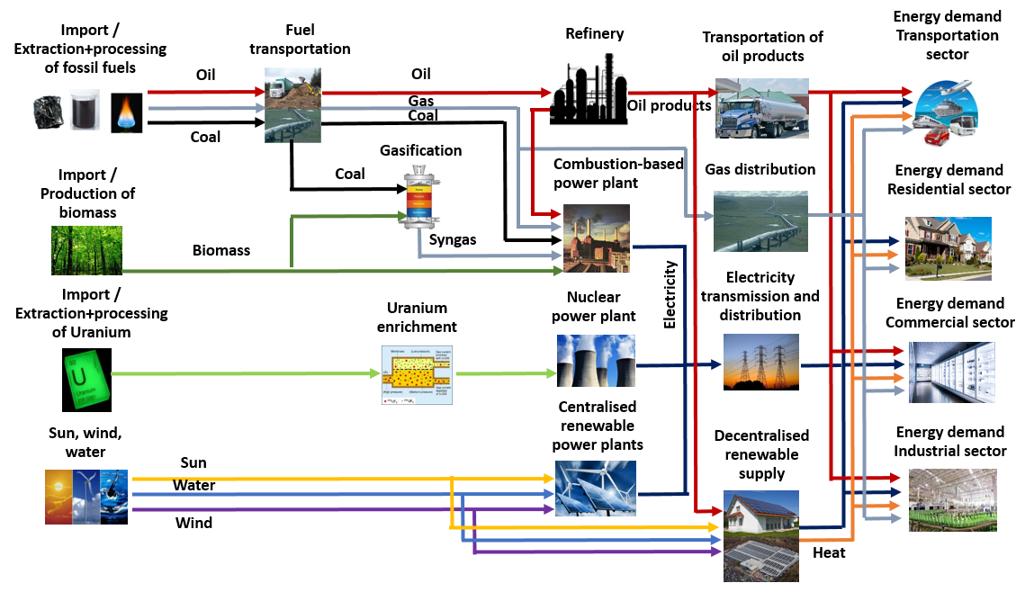
Reference Energy System
Notes:
Carro

Slide 4
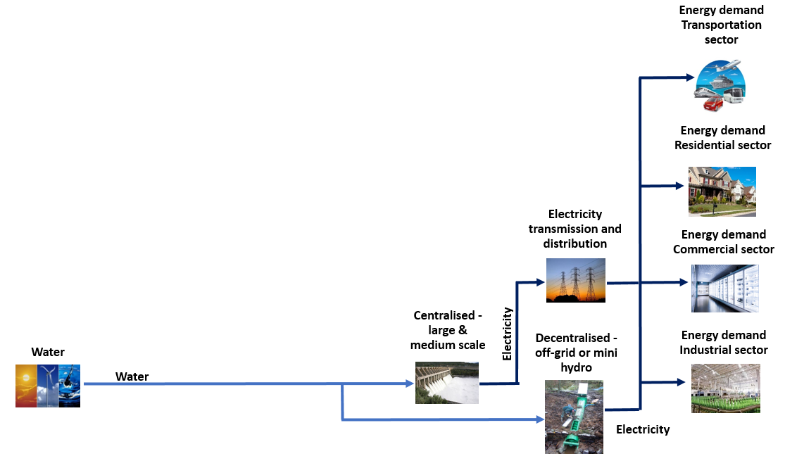
Reference Energy System – Hydropower
Notes:
Carro

Slide 5
Hydropower Social, environmental and economic concerns

Slide 6
Global Trends
Historical overview
Demand
Future generation
Global capacity
Global potential, generation & capacity

Slide 7
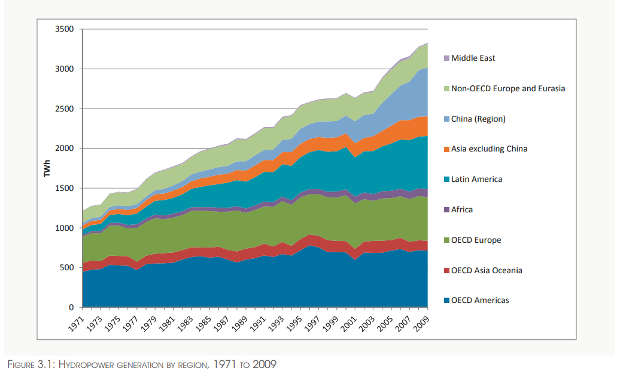
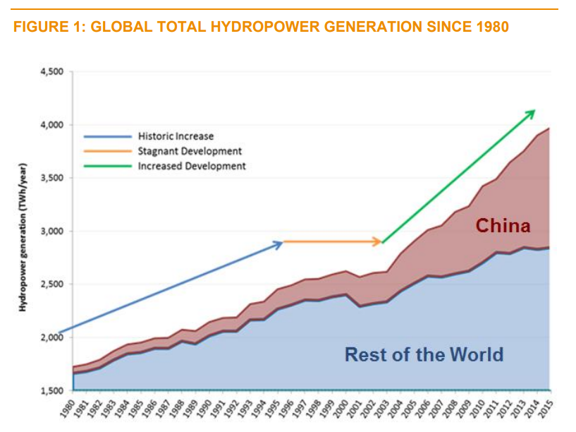
Historical overview
Historically an increase in hydropower generation
Source: IRENA (2012)
Source: World Energy Council (2016)
Notes:
Carro
Missing: water avalibhility for dams (stuff from Triese), tapped and untapped potentail

Slide 8
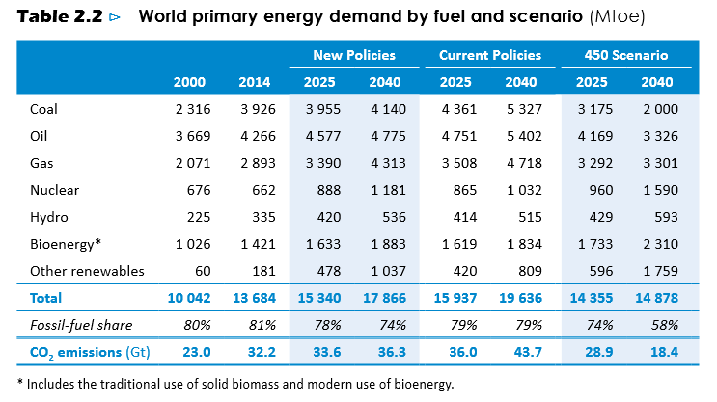
Demand
Despite large capacity and increase – not a major contributor to the energy demand
Source: IEA (2016)
Notes:
Carro
Note: here we are looking at energy demand – in many countries fossil fuel (oil, coal, gas) are being used AND in some countries they still use tradtional biomass (bioenergy). E.g. Ethiopia has over 90% of their ENERGY demand being meet by conventional biomass. Only a couple of percent is coming from electricity. HOWEVER, from the electricity more than 90% comes from hydropower.
450 – decarbonasation scenario
New policies – following new policies for countries, NDCs
Current – no new policies or additions

Slide 9
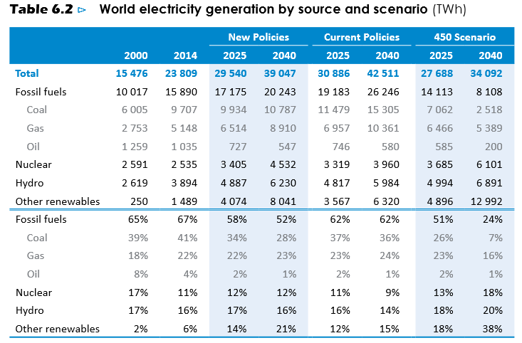
Future generation
Hydropower projected to increase its capacity – but remain fairly constant in terms of total share
In terms of renewables, particularly wind and solar PV will increase
Source: IEA (2016)
Notes:
Carro

Slide 10
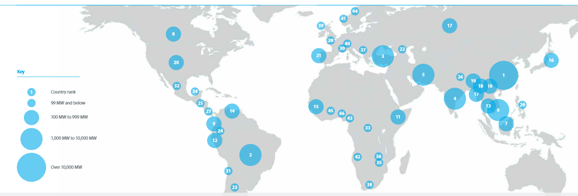
Global capacity
Capacity added in 2015
Source: IHA, 2016

Slide 11
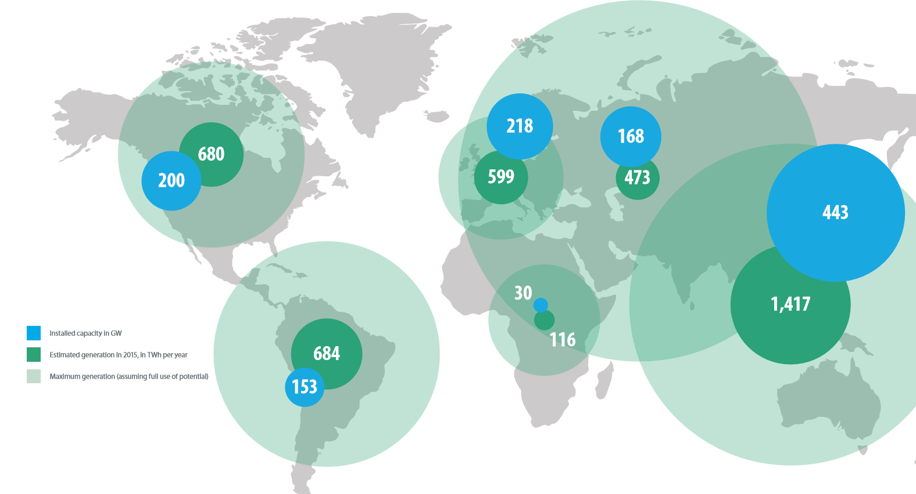
Global potential, generation & capacity
Technical potential, generation and installed capacity in 2015
During 2015: - 33.7 GW new installed capacity - 2.5 GW pumped storage (2016: 5 GW) - 1,212 GW global capacity - 3,975 TWh generation
China largest contributor
Source: IHA, 2016

Slide 12
Technologies in the hydropower chain
Introduction
Governing equations
Technology overview
Choice of turbines
Reservoir operation
Hydro specific technical parameters
Economic concerns
Environmental concerns
Social concerns
Climate Resilience

Slide 13
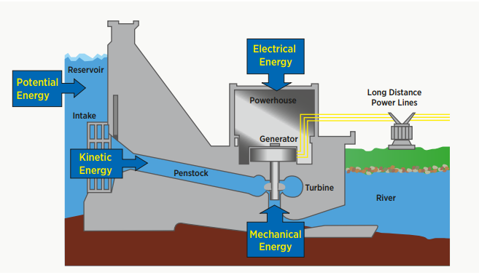
Introduction
A big advantage of hydroelectric power is the ability to quickly and readily vary the amount of power generated, depending on the load presented at that moment.
Source: Irena, 2012
Notes:
Carro
This is a general figure of the hydropower plant, but it does not need to have a reservoir. And there is also pumped storage. These will be covered later.
Talk about the different parts of the power plant. The valve, penstock, generation, powerhouse, transmission.

Slide 14
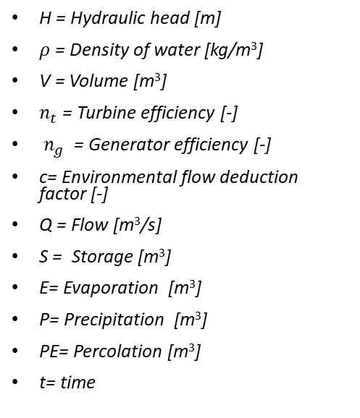
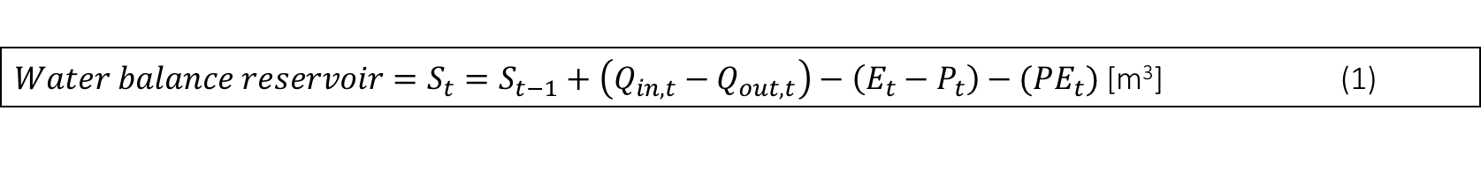
Governing equations
Note! Many different ways and conventions to write these equations
H = Hydraulic head [m]
$ρ$= Density of water [kg/m³]
V = Volume [m³]
$n_{t}$ = Turbine efficiency [-]
$n_{g}$ = Generator efficiency [-]
c= Environmental flow deduction factor [-]
Q = Flow [m³/s]
S = Storage [m³]
E= Evaporation [m³]
P= Precipitation [m³]
PE= Percolation [m³]
t= time
Source: Irena, 2012
$Water balance reservoir=S_{t}=S_{t−1}+\left(Q_{in,t}−Q_{out,t}\right)−\left(E_{t}−P_{t}\right)−{(PE}_{t})$ [m³] (1)
$Potential energy reservoir=E=ρ∗g∗h∗V [J]$ (2)
$Power output from hydropower=P=ρ ×g×n_{t}×n_{g}×c×\dot{Q}×h \left[W\right]$ (3)
Notes:
Conservation of mass – in a run of river then no real losses. But if we have a dam we will have evaporation, and smaller fraction of percolation.
Note that there are many different form of writing these equations.
Mention Percolation as an example: This can be very small most of the times. If you have a concrete dam, << small. But if it is rock, then larger.

Slide 15
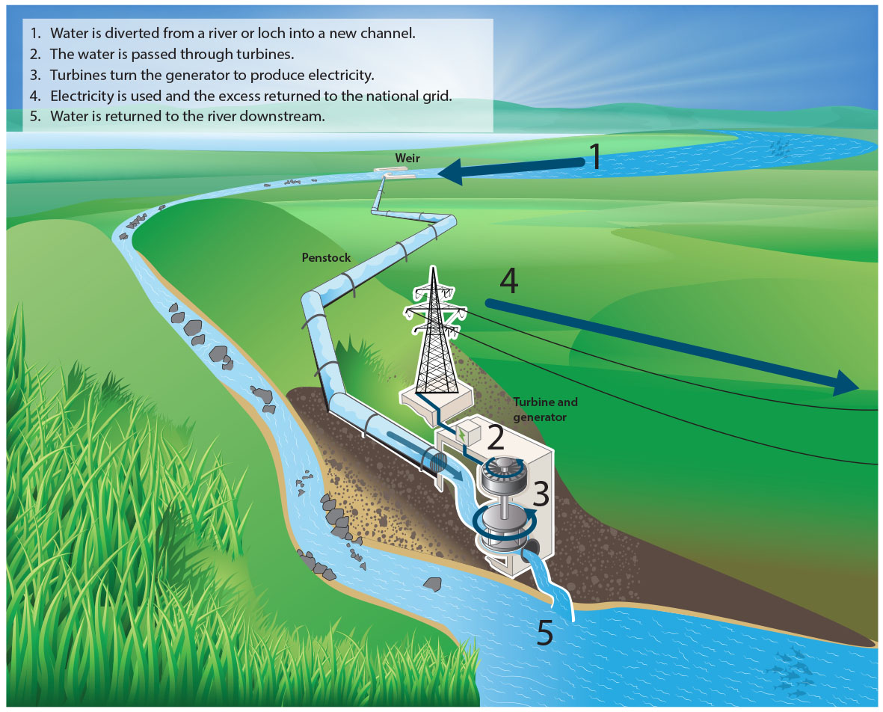
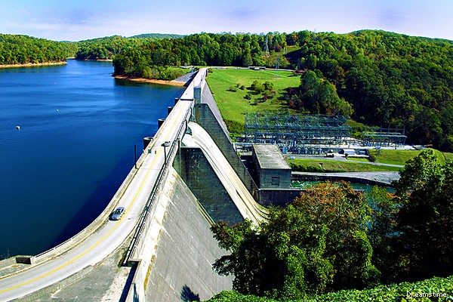
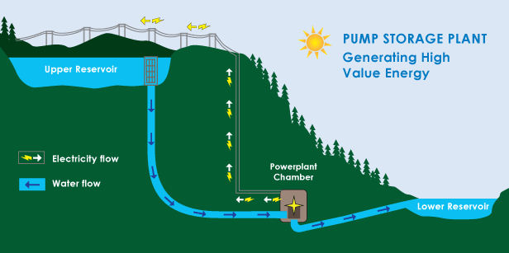
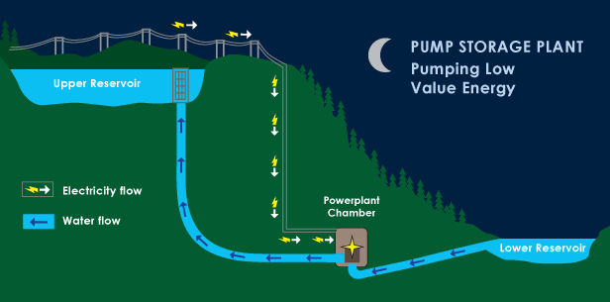
Technology overview
Classification of hydropower plants based on specification type
Run of the River plants
Storage hydropower
Pumped hydro storage
Hydropower: social, environmental and economic concerns
Notes:
Specification type refers to classification based on structural issues and the category of load the power plant is intended to satisfy
Run-of-the-river plants : Plants that channels flowing water from a river through a canal or penstock to spin a turbine. Typically a run-of-river plant will have little or no storage facility. Run-of-river provides a continuous supply of electricity (base load), with some flexibility of operation for daily fluctuations in demand
Storage hydropower: Plants facility that uses a dam to store water in a reservoir. Electricity is produced by releasing water from the reservoir through a turbine, which activates a generator. Storage hydropower provides base load as well as the ability to be shut down and started up at short notice according the demands of the system (peak load). It can offer enough storage capacity to operate independently of the hydrological inflow for many weeks or even months
Pumped-storage hydropower: This facility provides peak-load supply, harnessing water which is cycled between a lower and upper reservoir by pumps which use surplus energy from the system at times of low demand. When electricity demand is high, water is released back to the lower reservoir through turbines to produce electricity

Slide 16
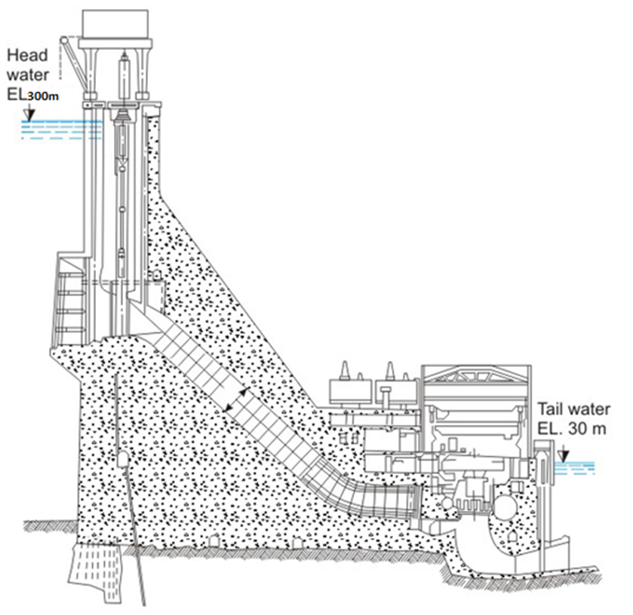
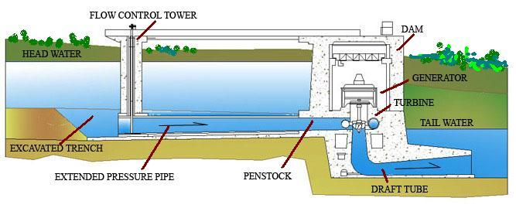
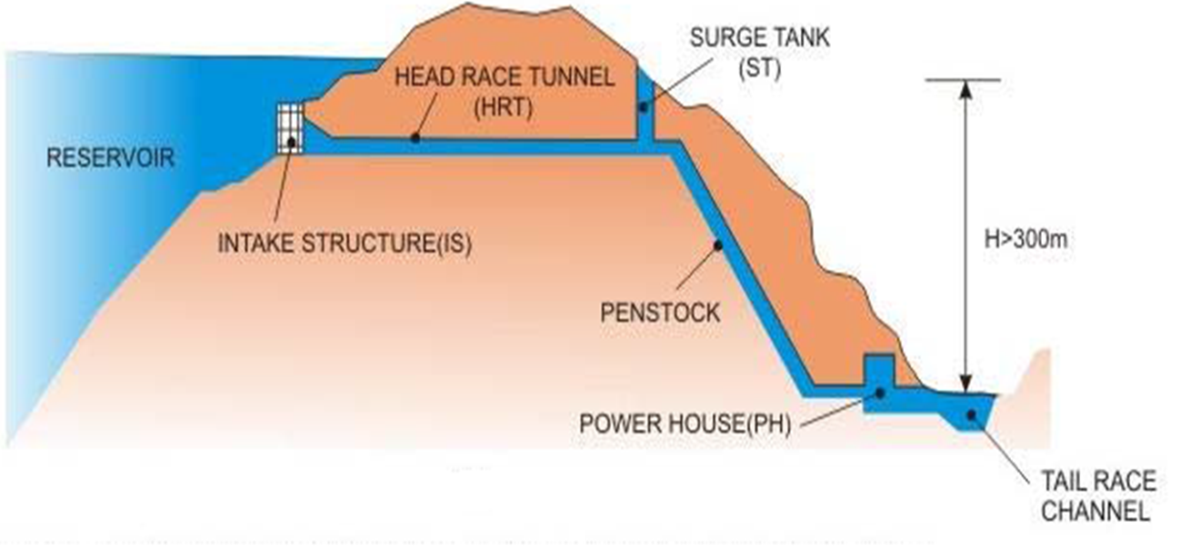
Technology overview
Classification of hydropower plants based on head
High Head
Low head
Medium Head
Notes:
The hydro plants are also classified according to the “Head” or the vertical distance through which the water is made to impact the turbines. (source: https://www.intechopen.com/books/energy-conservation/hydro-power), https://goo.gl/76SLVi
Low Head : Low head hydro power applications use river current of 30 meters or less to produce energy. These applications do not need to dam or retain water to create hydraulic head, the head is only a few meters. Using the current of a river or the naturally occurring tidal flow to create electricity may provide a renewable energy source that will have a minimal impact on the environment.
Medium Head: A power station operating under heads from 30m to 300m
High Head : A power station operating under heads above about 300m. These are the most commonly constructed hydroelectric power plants. In the high head hydroelectric power plants huge dams are constructed across the rivers. There is large reservoir of water in the dams that can store water at very high heads. Water is mainly stored during the rainy seasons and it can be used throughout the year. Thus the high head hydroelectric power plants can generate electricity throughout the year. The high head hydroelectric power plants are very important in the national grid because they can be adjusted easily to produce the power as per the required loads.

Slide 17
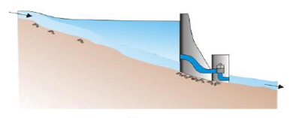
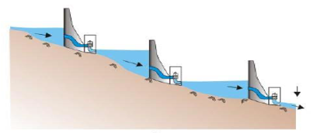
Technology overview
Classification of hydropower plants based on hydrological sequence
Single stage power plants
Cascade/Multistage hydropower plants
Notes:
SINGLE STAGE- When the run off from a single hydropower plant is diverted back into river or for any other purpose other than power generation, the setup is known as Single Stage
CASCADE SYSTEM- When two or more hydropower plants are used in series such that the runoff discharge of one hydro power plant is used as the is a intake discharge of the second hydro power plant such a system is known as Cascade hydropower plant.

Slide 18

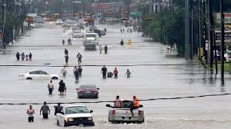
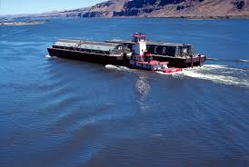
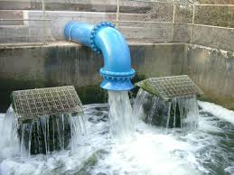
Technology overview
Classification of hydropower plants (Reservoirs) based on the purpose
Multi-purpose reservoirs
Water supply
Flood control
Soil erosion
Environmental management
Hydroelectric power generation
Navigation
Recreation
Irrigation

Slide 19
Technology overview
Classification of hydropower plants based on Size
LARGE: >100 MW
MEDIUM: 25 – 100 MW
SMALL: 1-25 MW
MINI: 100 KW - 1MW
MICRO: 5 – 100 KW
PICO: < 5 KW

Slide 20
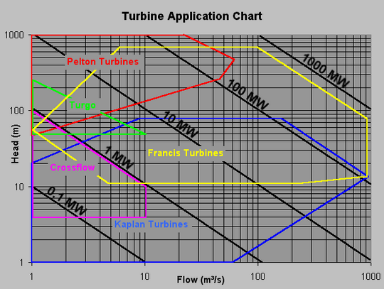
Choice of turbines
Reaction Turbines
Francis turbine
Kaplan turbine
Tyson turbine
Gorlov helical turbine
Impulse turbine
Pelton wheel
Turgo turbine
Cross-flow turbine
Jonval turbine
Screw turbine
Source: Irena-ETSAP- technology briefs
Notes:
Reaction turbines
Reaction turbines are acted on by water, which changes pressure as it moves through the turbine and gives up its energy. They must be encased to contain the water pressure (or suction), or they must be fully submerged in the water flow. Most water turbines in use are reaction turbines and are used in low (<30 m) and medium (30–300 m) head applications. It is largely used in dam and large power plants.
Impulse turbines
Impulse turbines utilize the velocity of the water coming out of the jet to produce electricity. The jet pushes on the turbine's curved blades which changes the direction of the flow. The resulting change in momentum (impulse) causes a force on the turbine blades. Prior to hitting the turbine blades, the water's pressure (potential energy) is converted to kinetic energy by a nozzle and focused on the turbine. No pressure change occurs at the turbine blades, and the turbine doesn't require a housing for operation. Impulse turbines are often used in very high (>300m) head applications.

Slide 21
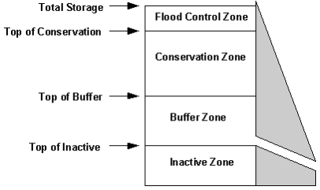
Reservoir operation
Maintained Empty
Utilized for downstream activities
Active Zone
Controlled Utilization for downstream activities
Not used
Source: WEAP(SEI) user manual
Notes:
For study purposes, reservoir storage is divided into four zones, or pools. These include, from top to bottom, the flood-control zone, conservation zone, buffer zone and inactive zone. The conservation and buffer pools, together, constitute the reservoir's active storage. It is to be ensured that the flood-control zone is always kept vacant, i.e., the volume of water in the reservoir cannot exceed the top of the conservation pool.

Slide 22
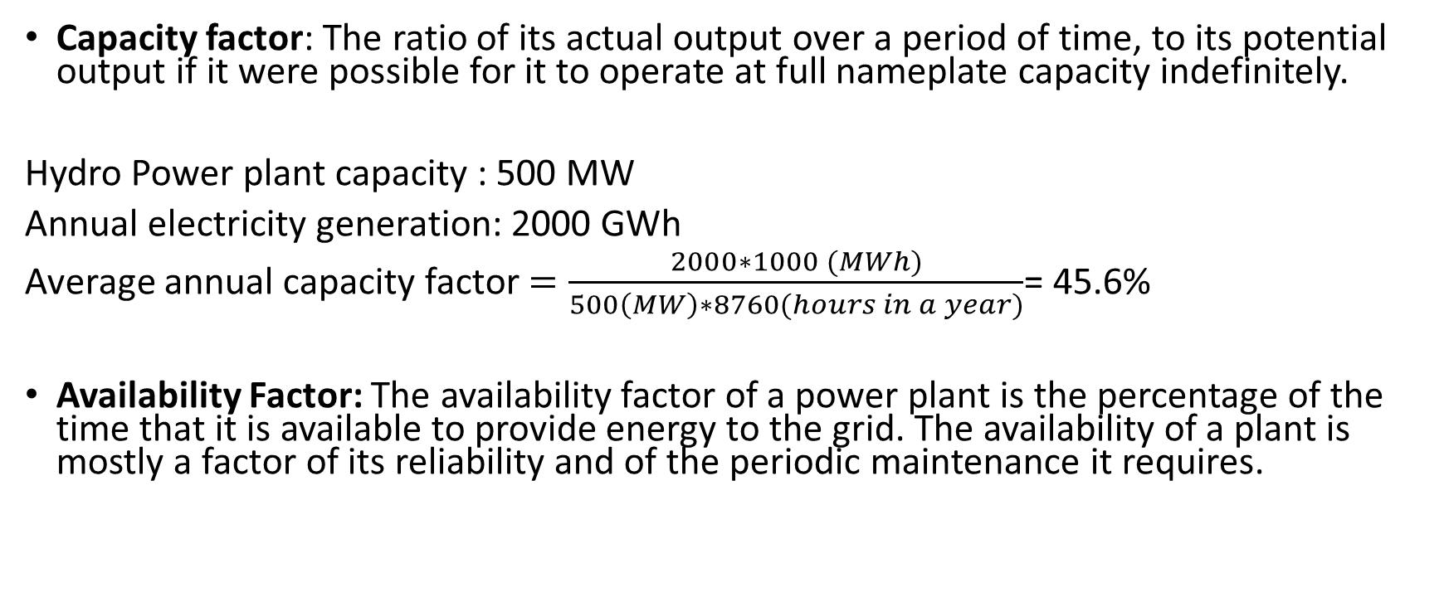
Hydro specific technical parameters
Capacity factor: The ratio of its actual output over a period of time, to its potential output if it were possible for it to operate at full nameplate capacity indefinitely.
Hydro Power plant capacity : 500 MW
Annual electricity generation: 2000 GWh
Average annual capacity factor $=\frac{2000∗1000 (MWh)}{500\left(MW\right)∗8760(hours in a year)}$= 45.6%
Availability Factor: The availability factor of a power plant is the percentage of the time that it is available to provide energy to the grid. The availability of a plant is mostly a factor of its reliability and of the periodic maintenance it requires.
Notes:
Because a plant is available, it does not mean that it can generate all of its nameplate capacity. For instance, a hydroelectric plant may be available, but it may not be possible to release all the water needed for it to reach its rated output.

Slide 23
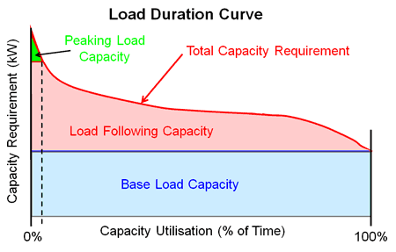
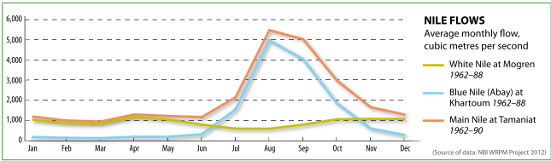
Hydro specific technical parameters
Load curves
Notes:
Load duration curve: Hydroelectric power plants can operate as base load, load following or peaking power plants. They have the ability to start within minutes, and in some cases seconds. How the plant operates depends heavily on its water supply as many plants do not have enough water to operate anywhere near their full capacity on a continuous basis.
Lakes and man made reservoirs used for hydropower come in all sizes, holding enough water for as little as a one-day supply, or as much as a whole year's supply. A plant with a reservoir that holds less than the annual river flow may change its operating style depending on the season of the year. For example, the plant may operate as a peaking plant during the dry season, as a base load plant during the wet season and as a load following plant between seasons. A plant with a large reservoir may operate independently of wet and dry seasons, such as operating at maximum capacity during peak heating or cooling seasons.
Nile River Flows:
Yellow curve-White Nile,
Blue curve-Blue Nile,
Orange-Main Nile
The idea is to explain how many power plants on the white nile (Uganda) are ROR and base load power plants.
And the GERD is beign built to streamline or Spread the water avaialbility of the blue curve. And also generate electricity over the entire year and not just in the rainy season.

Slide 24
Economic concerns
Hydropower costs
The civil works for the hydropower plant construction, including any infrastructure development required to access the site and the project development costs.
Dam and reservoir construction;
Tunneling and canal construction;
Powerhouse construction;
Site access infrastructure (roads etc);
Grid connection;
Engineering, procurement and construction (EPC);
Developer/owners costs (including planning, feasibility, permitting, etc.)
The cost related to electro-mechanical equipment.
Turbines, generators, transformers, cabling and control systems

Slide 25
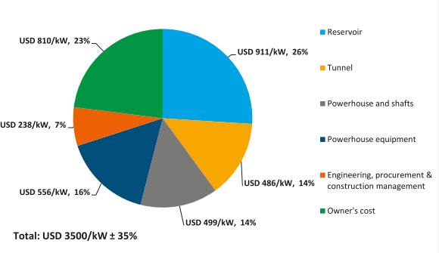
Economic concerns
Cost breakdown of an indicative 500 MW power plant in USA
source: Irena renewable energy technologies: cost analysis series
Notes:
Irena Power 3/5

Slide 26
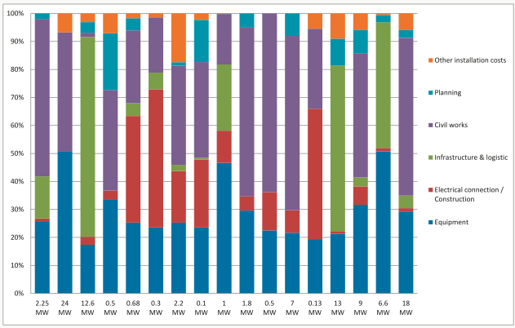
Economic concerns
Cost breakdown for small hydro projects in developing countries
source: Irena renewable energy technologies: cost analysis series
Notes:
In some cases, the reservoir (civil works) costs are very high but the equipment costs are more or less constant over different plants of the similar sizes.
Civil is high → this is where dams are constructed.
High red → not close to grid maybe
Not a linear relationship

Slide 27
Economic concerns
Representing costs in technoeconomic analysis
Capital/Investment costs
Operational & Maintenance costs
source: Irena –ETSAP technology briefs
Notes:
We can ask if they know th differnce between the costs. If majority do not know, we will have to explain.
Capital = investment. E.g. infrastrucutre, loan + interest rate. One-time investments done when for instance pruchasing the land, constructing etc.
O/M = fixed costs assigned to oprating and maintaing the power plant.
You can have variable as well (usually very low for hydro + how people report costs)

Slide 28
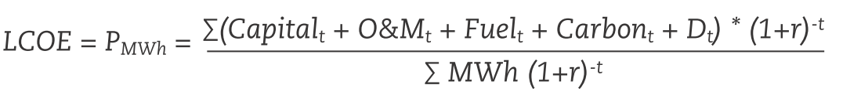
Economic concerns
How much does it cost to produce electricity from hydropower plants
LCOE- Levelized cost of electricity generation
P _{MWh} = The constant lifetime remuneration to the supplier for electricity;
MWh = The amount of electricity produced in MWh, assumed constant;
(1+r) ^{-t} = The discount factor for year t (reflecting payments to capital);
Capital _{t} = Total capital construction costs in year t;
O&M _{t} = Operation and maintenance costs in year t;
Fuel _{t} = Fuel costs in year t;
Carbon _{t} = Carbon costs in year t;
D _{t} = Decommissioning and waste management costs in year t.

Slide 29
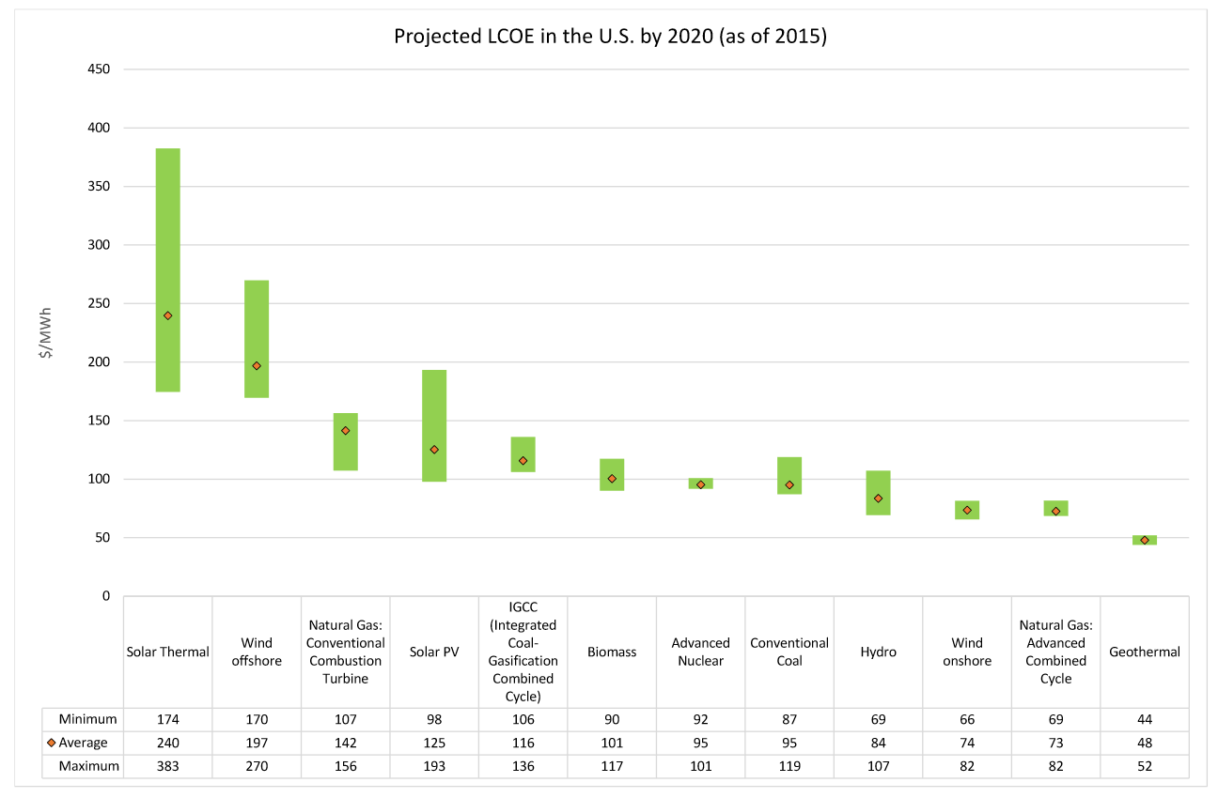
Economic concerns
Notes:
Diesel is probably higher than solar thermal → they have high variable cost
Geo → high exploration cost. Need to drill for the source.
Natural gas: advanced is probably high efficiency

Slide 30
Environmental concerns
”It is a renewable energy source, so it is environmentally friendly”
Hydropower is a component in a larger system – system thinking required

Slide 31
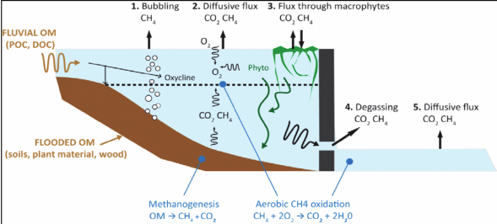
Environmental concerns
Modification of primary watersheds
Change of landscape (inundation of large areas, deflection of rivers, creation of new infrastructure, loss of productive land/soils)
Destruction of habitats & ecosystems - threat to flora and fauna
Changes in river flow regime
Possible emissions of methane (degradation of flora/organic matter in stagnant water)
Deterioration of water quality – algae and oxygen depletion
Sedimentation – storage capacity goes down, area of freshwater decreases & ecosystem impacts
Reading recommendations: The greater common good
Source: Kumar & Sharma (2012)
Notes:
Carro
An estimated 0.5–1% of the total fresh water storage capacity of existing dams is lost each year to sedimentation in both large and small reservoirs worldwide.

Slide 32
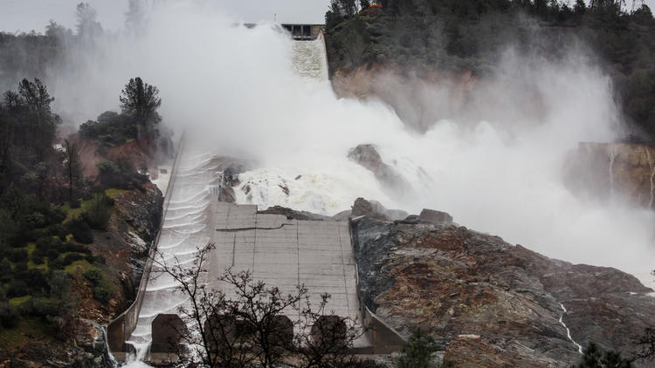
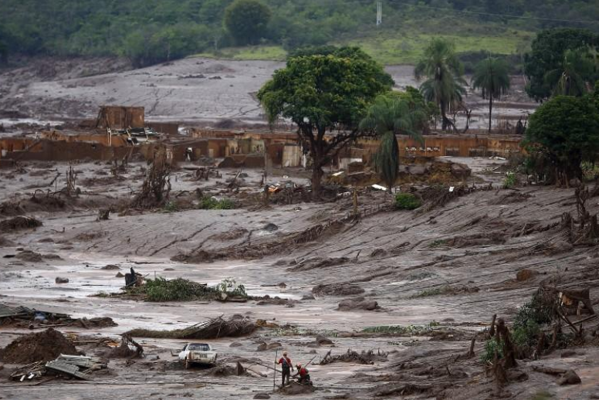
Environmental concerns
Flash floods – rapid flooding due to, among others, heavy precipitation and dam failure
Oroville Dam - California floods 2017
Samarco dam holding waste from Iron ore mine - Brazil 2015
Source: Los Angeles Times (2017)
Source: Reuters (2017)
Notes:
Oroville: heavy rain, the main concrete spillaway crumbled and led to a cascading set of problems, the emergency spillway partially broke, 100,000 people downstream had to be evacuated, before the break the firesquad cleared the area from trees etc so avoid larger damage and Department of Fish and Wildlife started to evacuate fish from a hatchery downstream.
Brazil: dam broke, contaminated water was spread, caused health and environmental prolems. And cause people downstream 100km to be affected by the floods. 300mkm downstream had to cut out the drinking water.
https://sf.curbed.com/maps/california-floods-storm-damage-map
http://www.latimes.com/local/lanow/la-me-ln-dam-flood-season-reassessments-20170728-story.html
https://www.cnbc.com/2017/02/10/northern-california-tracking-to-have-wettest-year-on-record.html
http://www.reuters.com/article/us-brazil-damburst/brazil-mine-dam-burst-endangers-water-supply-far-downstream-idUSKCN0SY1Y920151109
https://www.theguardian.com/sustainable-business/2016/oct/15/samarco-dam-collapse-brazil-worst-environmental-disaster-bhp-billiton-vale-mining

Slide 33
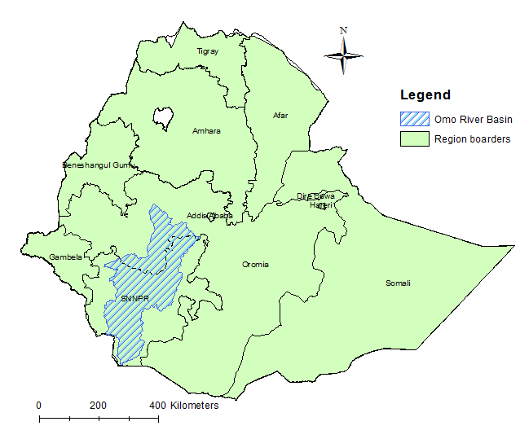
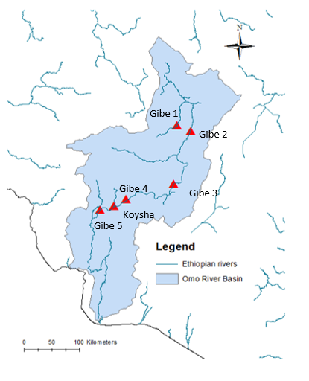
Environmental concerns
Omo River Basin in Ethiopia
Gibe cascading scheme – currently 3 power plants operation with more planned
Major inflow to Lake Turkana, Kenya, in the south
Gibe 3: 1,870 MW & 14,700 Mm3
Source: Sundin (2017) – adopted from Boulos (2017)
Notes:
Outflow to Lake Turkana – major contribution to the lake. Change in stream flow would change lake levels

Slide 34
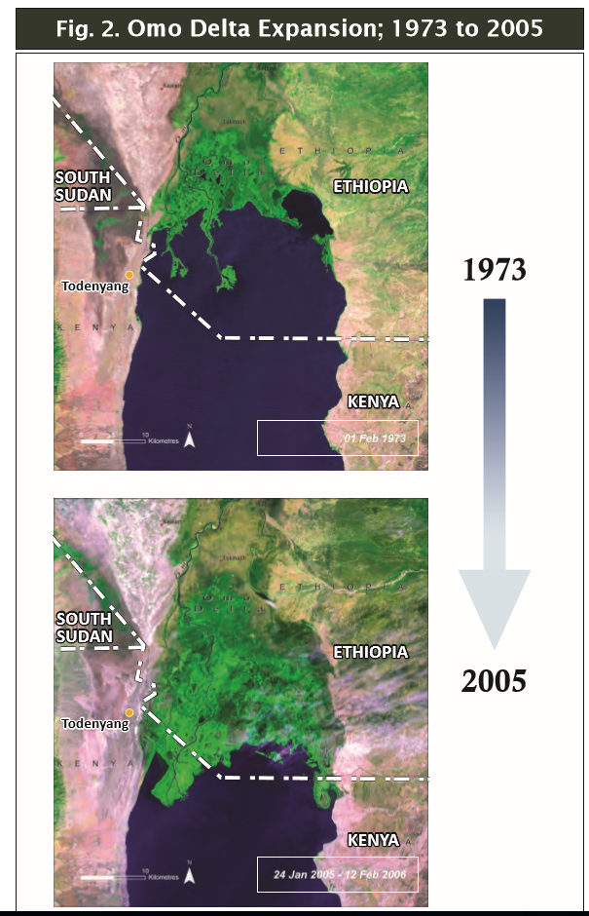
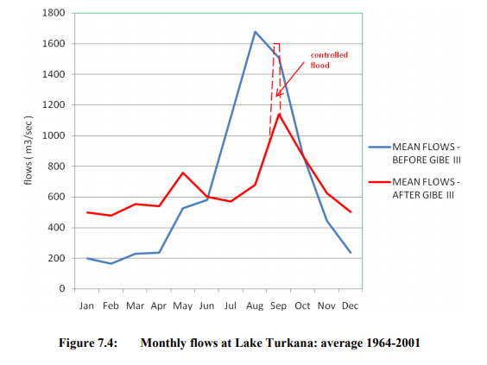
Environmental concerns
Disruption in natural water balance
Change in stream flow regime
Change in Lake Turkana lake levels
Change in river delta
And other – some not yet observed
Source: Avery (2012)
Source: Carr (2012)
Notes:
Stream flow regime changes – store water and release at different times than than normal fluctuations
Delta – due to silt or sediment transportation

Slide 35
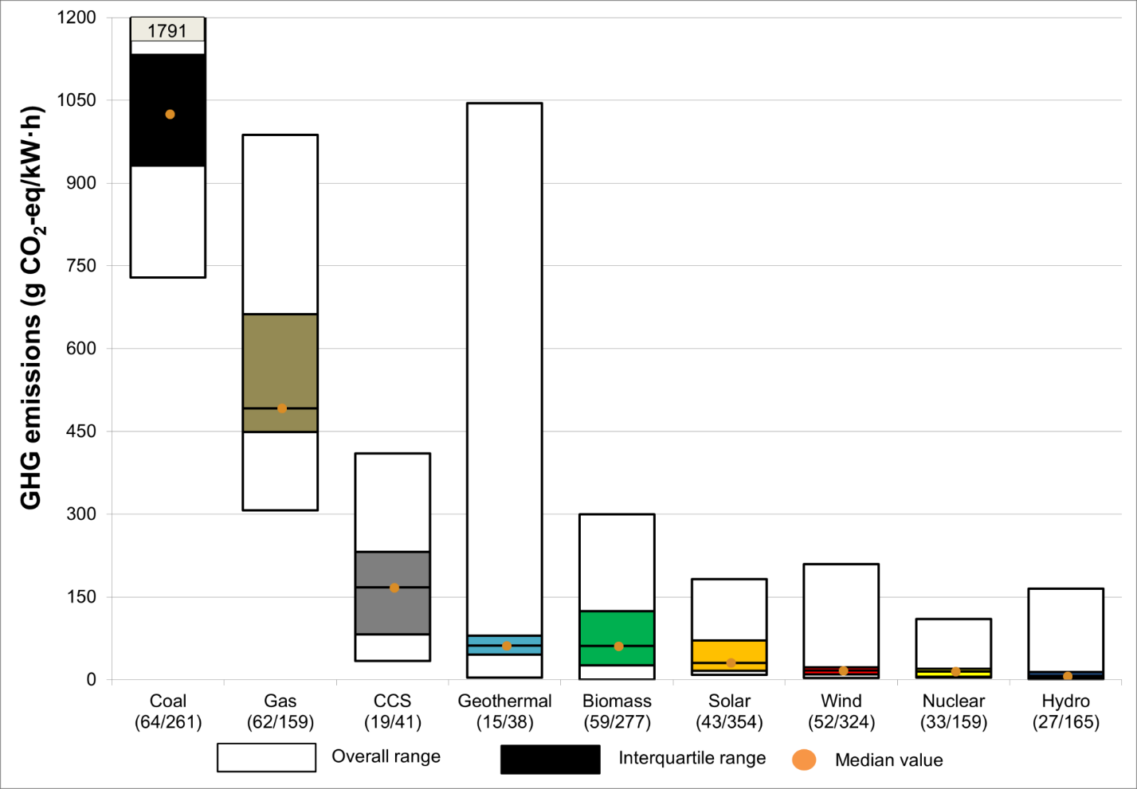
Environmental concerns
Comparison of GHG-emissions between technologies
Hydropower – not carbon neutral if considering its entire life cycle:
Construction and maintenance (material, transport etc.)
Reservoirs (methane gas – as discussed earlier)
Notes:
You will have direct emissions – from the operation of power plant. And indirect – from production, i.e. Waste, material, transport, construction and infrastructure.
Important: one often think that the emissions are located to the managment prior to the start, implying the operation is without emissions. However, there are other more indriect ones, for instance mathane gas from floodings of reservoirs. Some countries (e.g. Switzerland and finland) have started to develop a methodology to included this in their national greenhouse gas inverntories. Also, as discussed before the methane gas from stagnat water in the reservoir itself.

Slide 36
Social concerns
Large contributor to electrifying people
Generation possible to reflect the load
Resettlement of local inhabitants
Political and cultural conflicts
Large dams in 20th century – 40-80 million people worldwide
Sometime no direct benefits for local communities, electricity usually transferred over long distances – accessibility
Transboundary rivers – 260 rivers in the world cross at least one boundary
Multipurpose dams – However, competition of water – e.g. water for irrigation
Notes:
Transboundary: political complications. But also possibility to cooperate – mention Drina river basin.

Slide 37
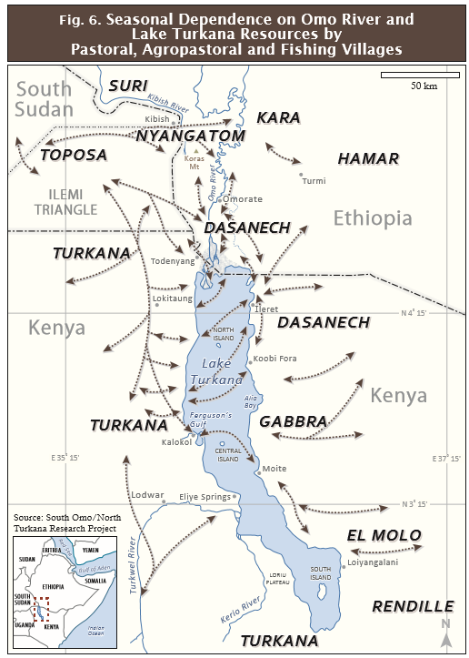
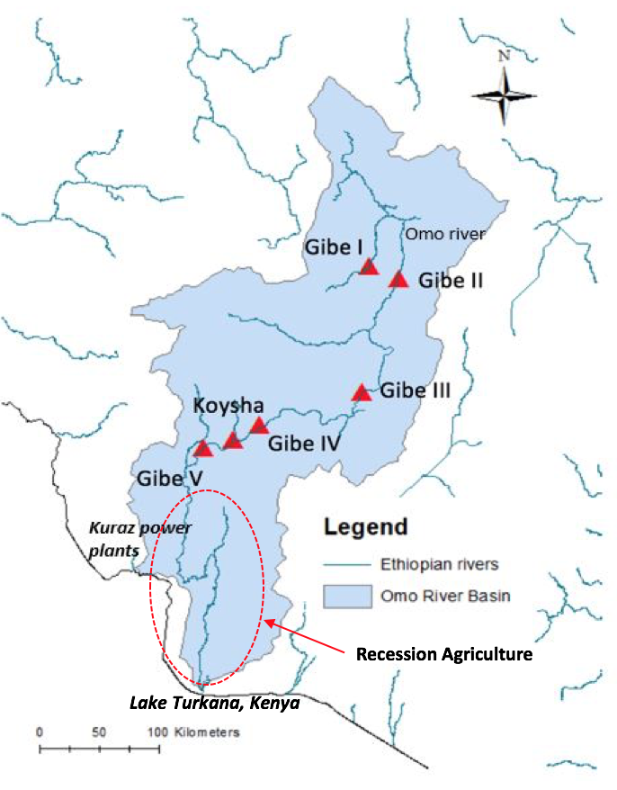
Social concerns
Omo River Basin
Indigenous people depending on seasonal flooding - Flood retreat cultivation
Source: Sundin (2017) – adopted from Boulos (2017)
Source: Carr (2012)
Notes:
Kuraz → in the middle of national parks
Gibe + Kuraz → flood retreat agriculture will be jeopardized

Slide 38
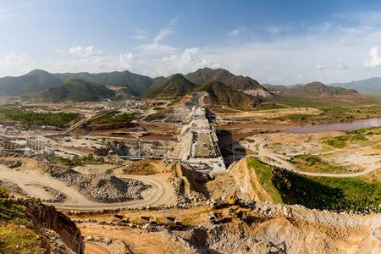
Social concerns
Financial implications: rehabilitation of displacement, creating new job opportunities, loss of agricultural land, import of food etc.
Grand Ethiopian Renaissance Dam Project – Nile River
When finished – largest dam in Africa
6,000 MW – 15,000 GWh/year
Geopolitics – Egypt example
Source: Salini Impreglio
Notes:
geopolitics. Egypt threats military actions. Threatening to pull out of EAPP
Egypt: At the end of Nile River. Certain amount of the flow of the Nile River is reserved – i.e. necessary for survival – in Egypt. High Aswan Dam regulates flood and ensure continuous water supply by storing water for urgent times – treaty from colonial time gives Egypt veto on all projects upstream. Egypt monitor the upstream countries to ensure their right of the flow. Ethiopia= 86% of the Nile River downstream flow – GRD dam to affect this. Nile River Basin serves as a platform to address this conflict.

Slide 39
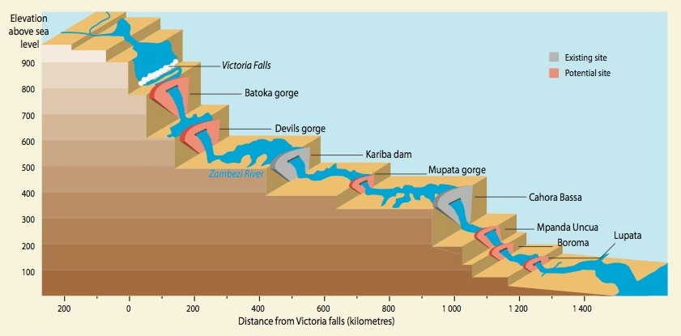
Hydropower- Climate Resilience
Precipitation and Temperature affect water availability for hydro power
If the future is
Dry: The energy system cannot depend only on Hydro
Wet: The energy system could take advantage of the increased water availability
Our Electricity infrastructure needs climate proofing
Example: Vulnerability of hydro-infrastructure development in the Zambezi River Basin
Extensive Hydropower expansion planned in the basin
The variation in the Zambezi river is highly variable
Potential for transboundary countries experiencing frequent blackouts or high electricity prices due to the loss of hydropower generation
Source: Zambezi River Basin Authority

Slide 40
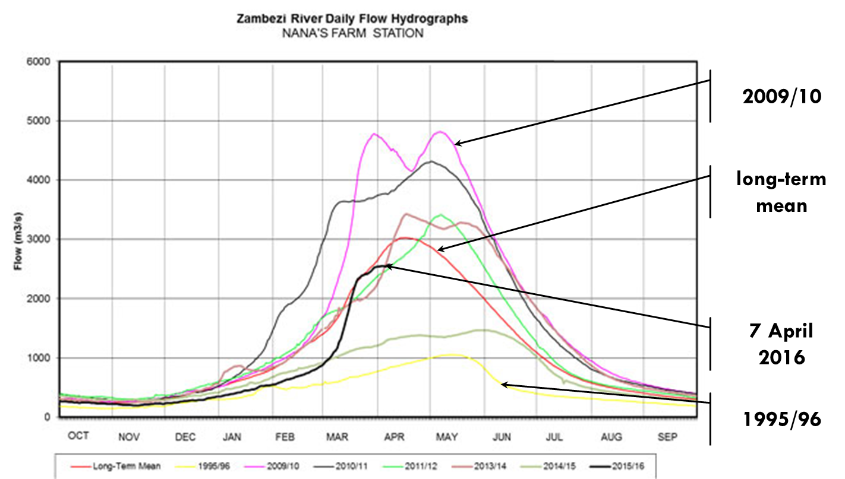
Hydropower- Climate Resilience
Our Electricity infrastructure needs climate proofing
Source: Zambezi River Basin Authority

Slide 41
Conclusions

Slide 42
Conclusions
Historic increase of hydropower capacity – today largest renewable
Untapped potential – varying between continents
Classification based on type, size, head, hydrological sequence and purpose of reservoir
Different turbines – reaction & impulse
Load curve – different rivers can meet demand at different times
Cost of hydro is a function of the size and locations
LCOE – hydropower one of the lowest
Pressure on the environment – flooding, ecosystems
GHG-emissions mainly from reservoirs and construction
Pressure on the society – resettlement, agricultural practises
Hydropower vulnerable to climate change – climate resilience
Notes:
MAKE A GAME WITH STUDENTS WITH THE STUDENTS HERE!!

Slide 43
Key take away messages

Slide 44
Key messages
Effects or benefits or hydropower production
Socio-economic
Climate
3. Low CO2 emissions
4. Electrification
Agricultural pressures
Hydropower
Methane emissions
Diffuse or indirect implications
1. Water availability
2.Production
Energy
Water
Changes of stream flow
Less storage – less generation
Notes:
Social, environmental and economic concerns – both from and on the hydropower plants – that needs to be taken into consideration when commissioning projects
Renewable less reliable to climatic variations
System thinking – component in a larger system

Slide 45
References
IRENA, 2012. Renewable Energy Technologies: Cost Analysis Series. Volume 1: Power Sector. Issue 3/5. Hydropower. Available at: https://www.irena.org/documentdownloads/publications/re_technologies_cost_analysis-hydropower.pdf
IRENA, 2015. Hydropower Technology Brief. Available at: http://www.irena.org/DocumentDownloads/Publications/IRENA-ETSAP_Tech_Brief_E06_Hydropower.pdf
Boulos, M., 2017. Social, Economic and Environmental Impact of Alternative Scenarios of Development in the Omo River Catchment. Streamflow simulation using the physically based hydrological model TOPKAPI-ETH. Thesis at Institute of Environmental Engineering, Department of Hydrology and Water Resources Management, ETH Zurich, February 2017.
Sundin, C, 2017. Exploring the water-energy nexus in the Omo River Basin - A first step toward the development of an integrated hydrological-OSeMOSYS energy model. Thesis at Institute of Environmental Engineering, Department of Hydrology and Water Resources Management, ETH Zurich, June 2017.
Avery, S., 2012. Lake Turkana & The Lower Omo: Hydrological Impact of Major Dam & Irrigation Development. African Studies Centre.
Carr, C. (2012): Humanitarian Catastrophe and Regional Armed Conflict Brewing in the Transborder Region of Ethiopia, Kenya and South Sudan: The Proposed Gibe III Dam in Ethiopia, Africa Resources Working Group, December 2012, http://assets.survivalinternational.org/documents/1282/gibe-iii-dam-report-carr-arwg.pdf
CESI and Mid-Day International Consulting Engineers, 2009. GIBE III Hydroelectric Project, Environmental and Social Impact. Ethiopian Electric Power Corporation (EEPCo).
Kumar, A., and Sharma, A. P., 2012. Greenhouse Gas Emissions from Hydropower Reservoirs. Available at: https://www.researchgate.net/publication/236590025_Greenhouse_Gas_Emissions_from_Hydropower_Reservoirs
IEA, 2016. World Energy Outlook 2016.
Los Angeles Times, 2017. 93 California dams need reassessment before next flood season, state agency says. Available at: http://www.latimes.com/local/lanow/la-me-ln-dam-flood-season-reassessments-20170728-story.html
Reuters, 2015. Brazil mine dam burst endangers water supply far downstream. Available at: http://www.reuters.com/article/us-brazil-damburst/brazil-mine-dam-burst-endangers-water-supply-far-downstream-idUSKCN0SY1Y920151109
World Energy Council, 2016. World Energy Resources - Hydropower 2016. Available at: https://www.worldenergy.org/wp-content/uploads/2017/03/WEResources_Hydropower_2016.pdf
IHA, 2016. Hydropower status report 2016. International hydropower association limited.

Slide 46
Changelog and attribution
Date | Author | Reviewer | Reviser
2017-10-10 | Caroline Sundin | Mark Howells | Caroline Sundin
To correctly reference this work, please use the following:
Sundin, C., 2017. Hydropower: Social, environmental and economic concerns, OpTIMUS.community. Available at: http://www.osemosys.org/understanding-the-energy-system.html. [Access date]

